Slide 1
Zaterdag 15 maart 2025

Slide 2
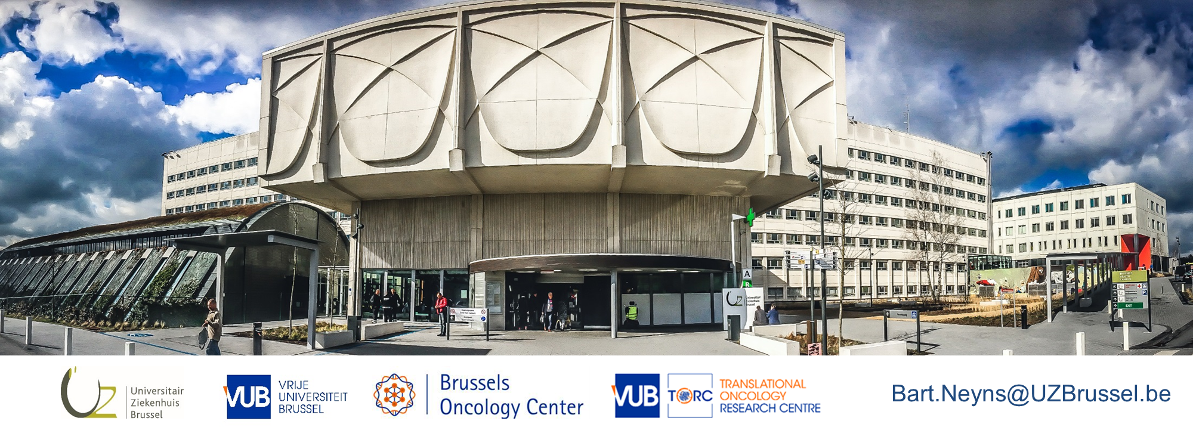
Immuun-checkpoint blokkade bij de behandeling van hooggradige gliomen
Prof Bart Neyns, MD PhD
Diensthoofd Medische Oncologie
Universitair Ziekenhuis Brussel
Vrije Universiteit Brussel
België

Slide 3
DISCLOSUREs
Personal financial compensation from Bristol-Myers Squibb, Merck Sharp & Dohme, Roche, and Novartis for public speaking, consultancy and participation in advisory board meetings
My institution (UZ Brussel) received research funding related to research projects conducted by my team from Pfizer, Novartis, Roche, Merck-Serono

Slide 4
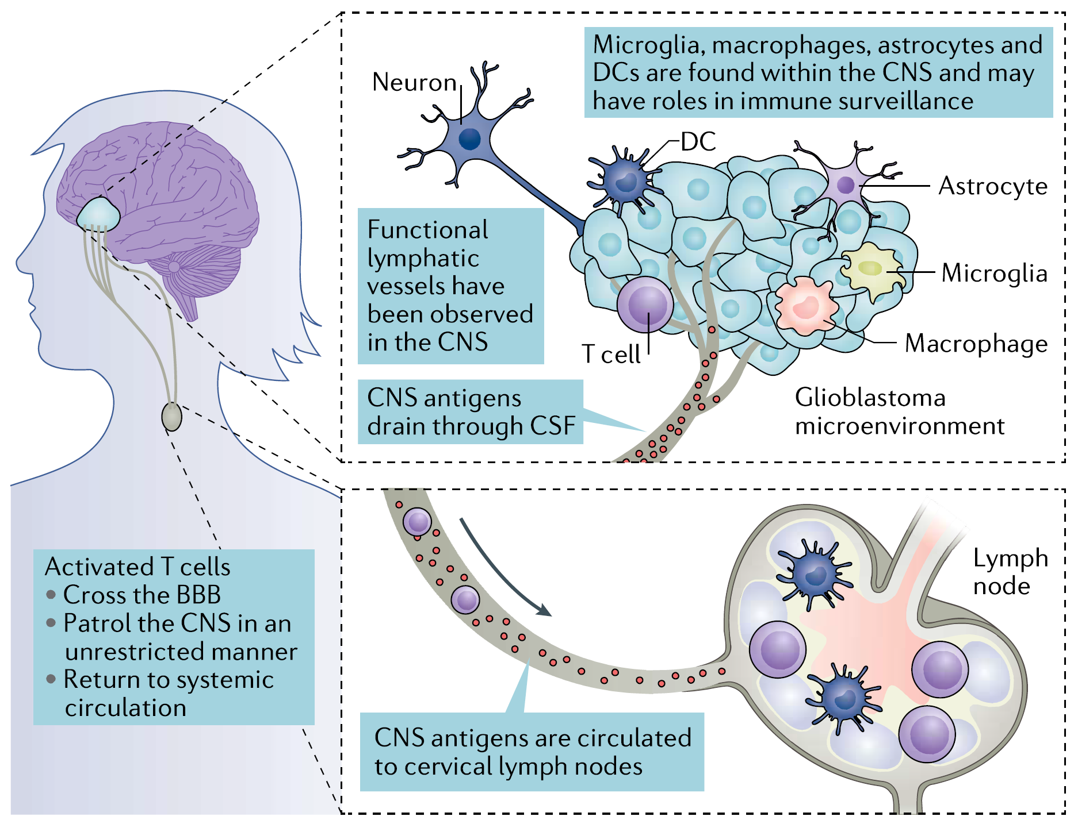
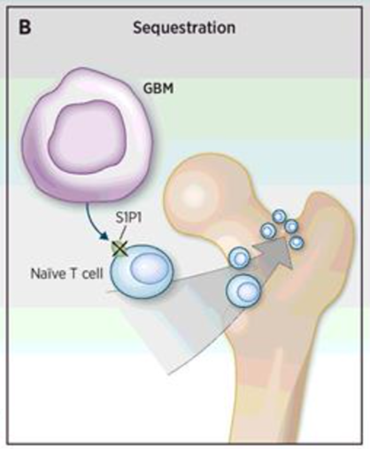
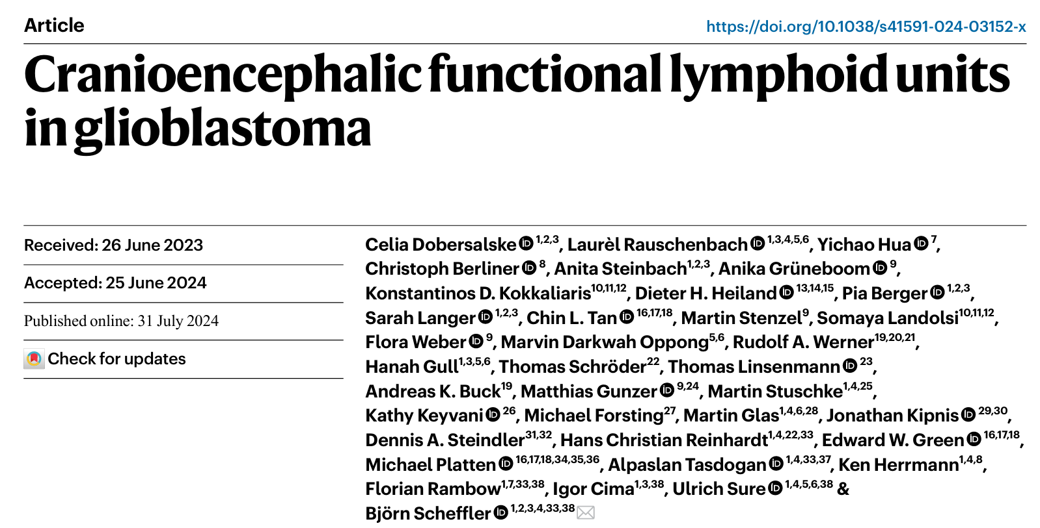
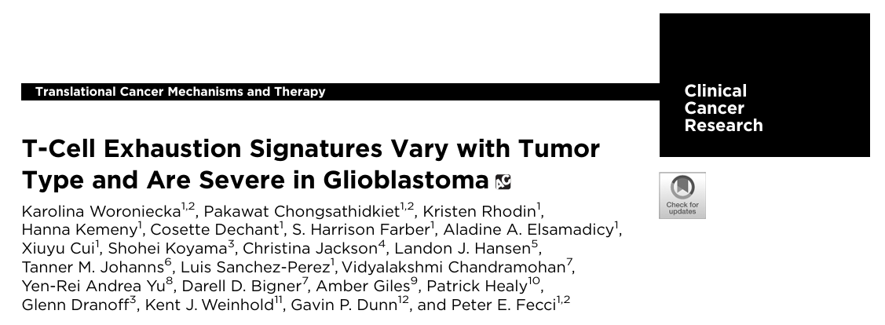
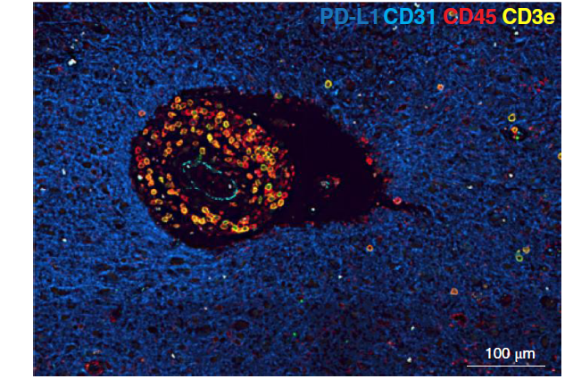
Brain Metastases
High Grade Glioma
P Chongsathidkiet et al. Nature Medicine 2018
JH Sampson et al. Nature 2020

Slide 5
Brain Metastases
High Grade Glioma

Slide 6
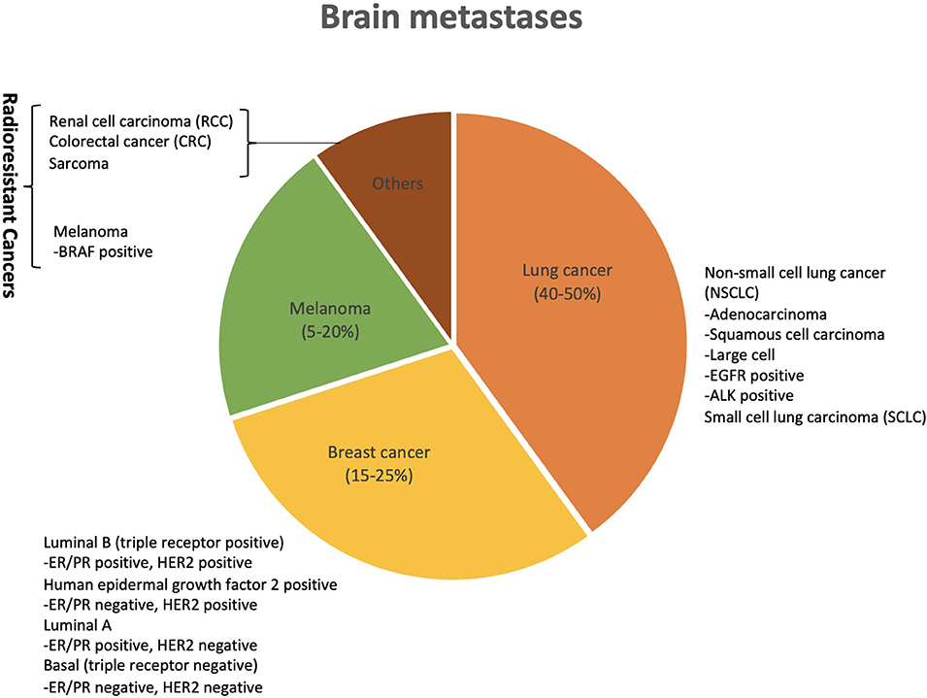
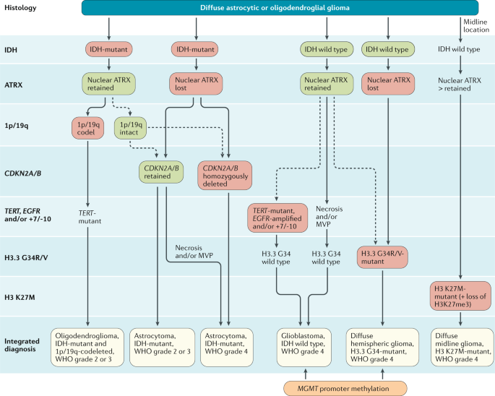
Brain Metastases
High Grade Glioma
Khan M. et al. Front. Oncol. (2020)
M Weller et al. Nature Reviews Clinical Oncology(2021)

Slide 7
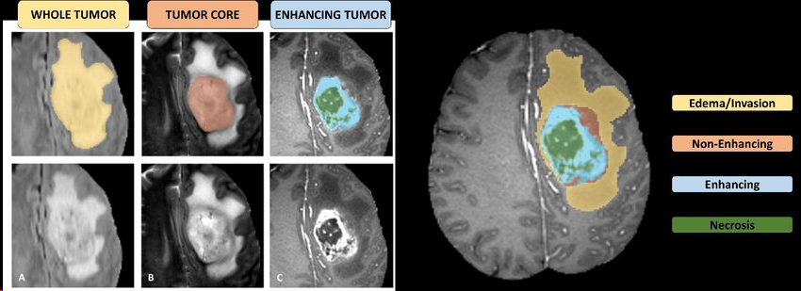
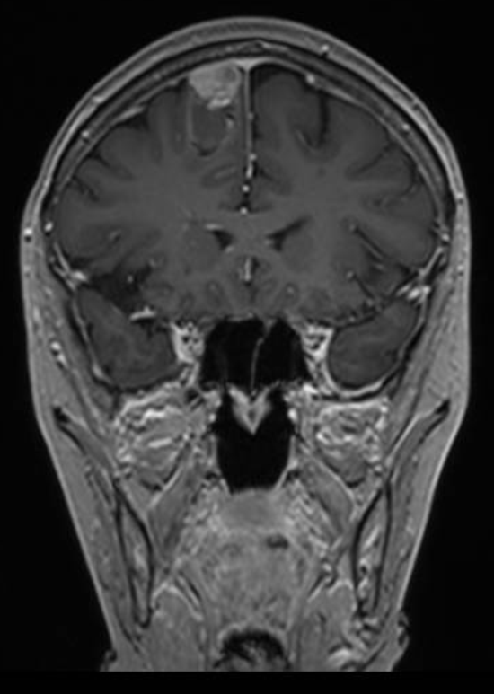
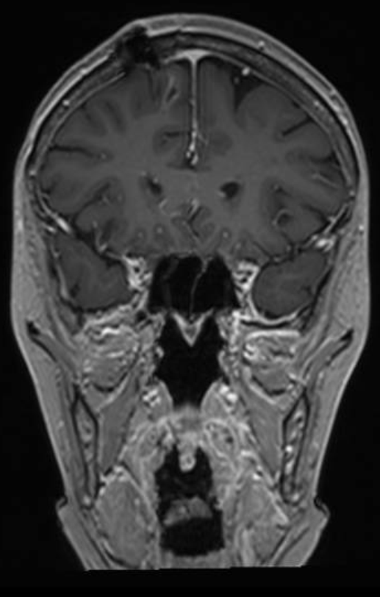
Brain Metastases
Surgery and radiation therapy
High Grade Glioma
Delineated
R1-0 surgery
SRS/SRT
Diffuse glioma
R1 or-2 surgery
Fractionated RT (30x2Gy) + Temozolomide
Respectively 73% and 40% of pts have CD4 counts of <300 and <200 cells/mm³
Stupp R. et al NEJM 2005; Bakas et al. (2019); Grossman SA et al. Clin Cancer Res. (2011)

Slide 8
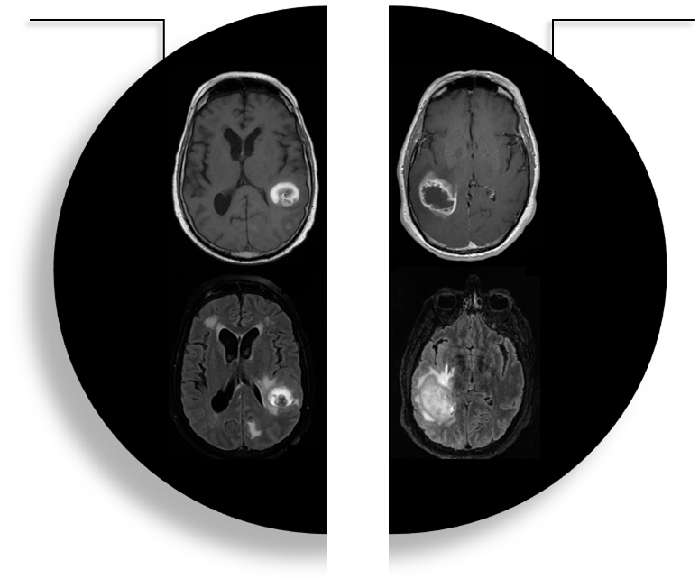
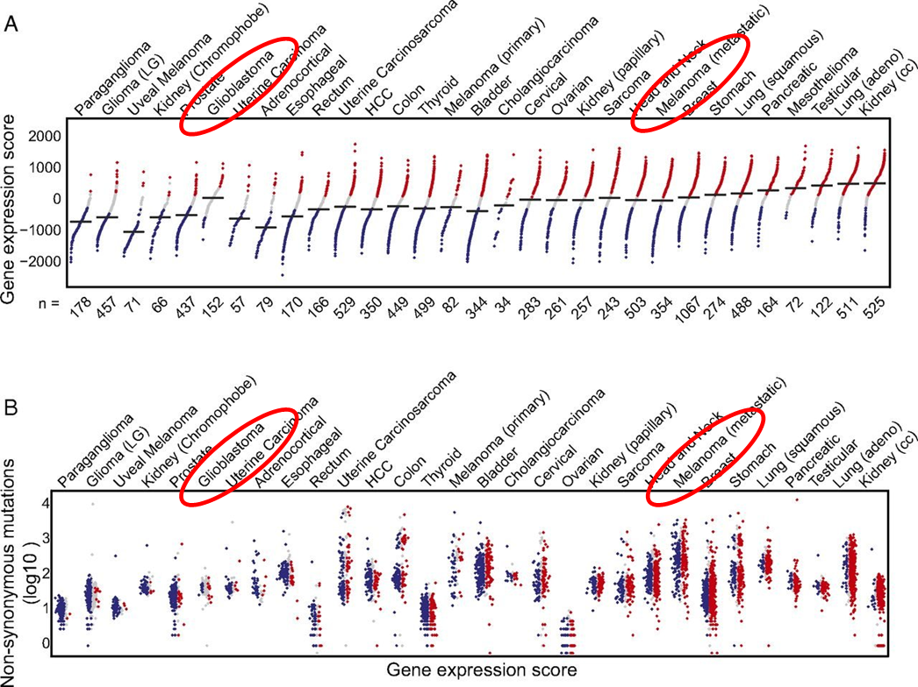
Brain Metastases
Immune Checkpoint Blockade
High Grade Glioma
S Spranger et al. PNAS November 11, 2016

Slide 9
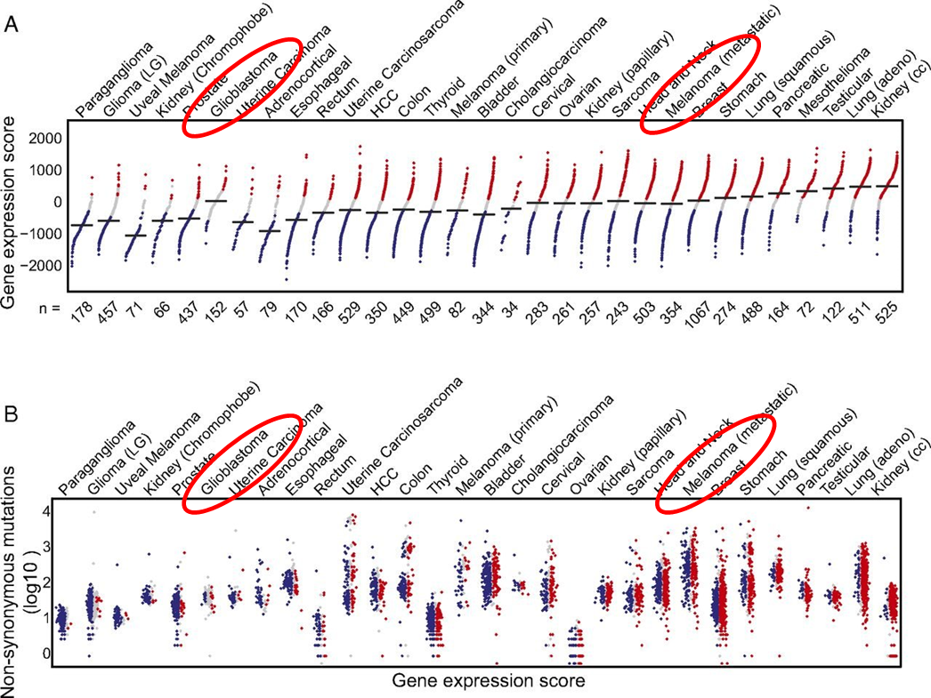
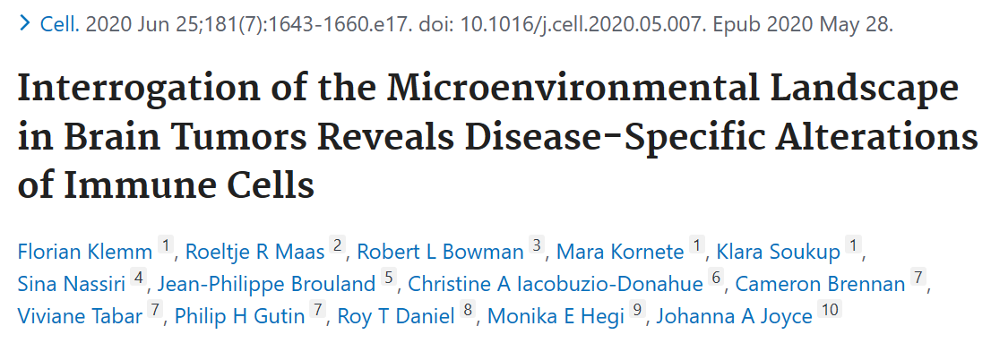
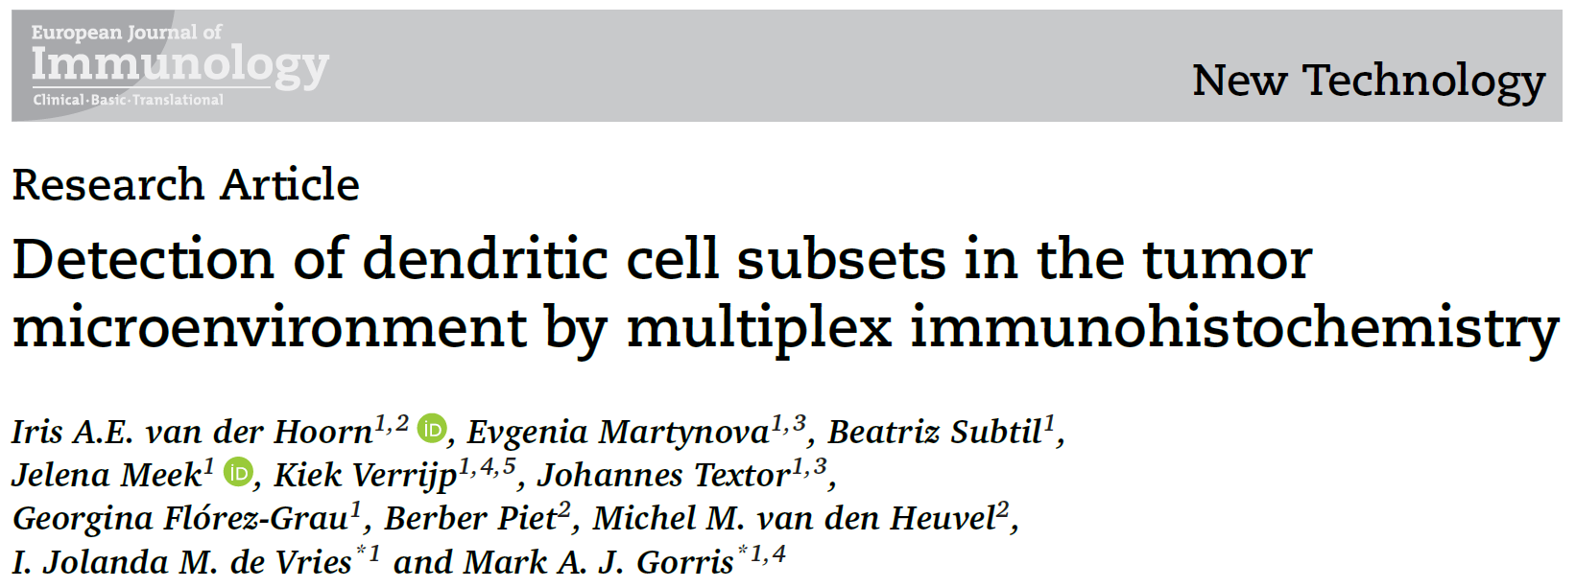
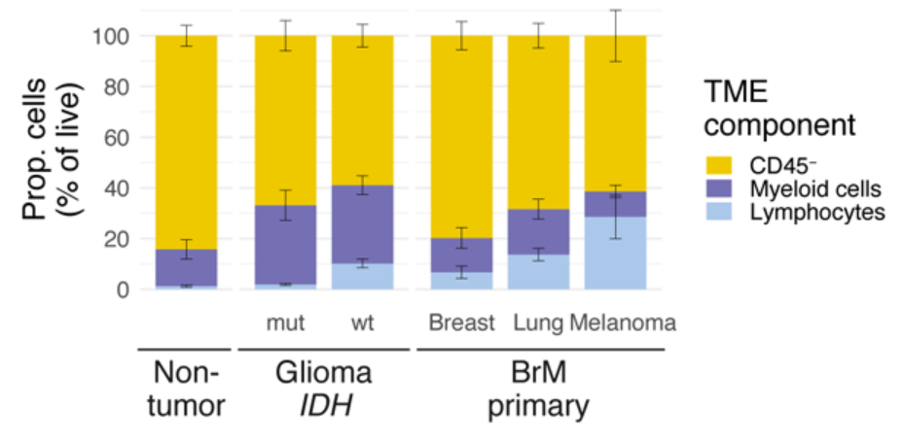
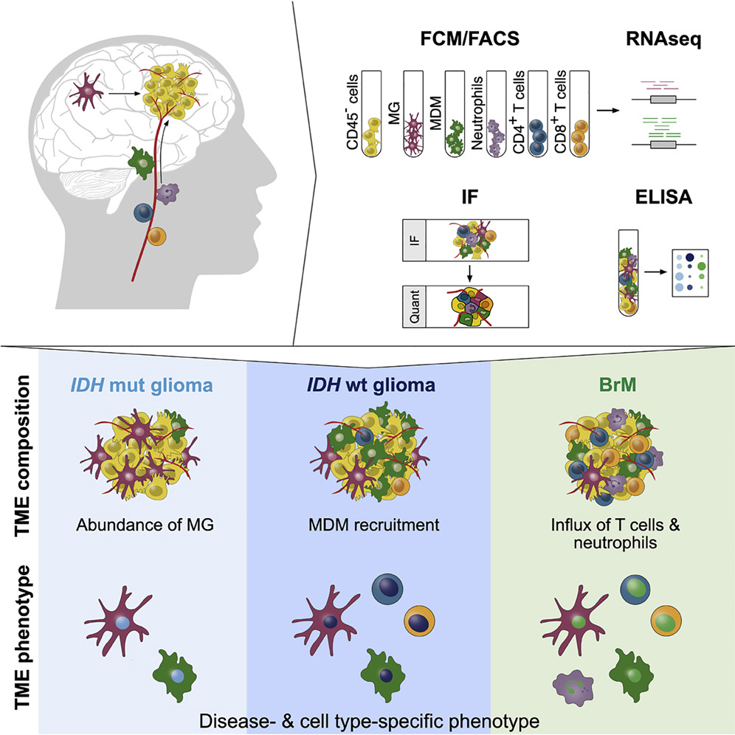
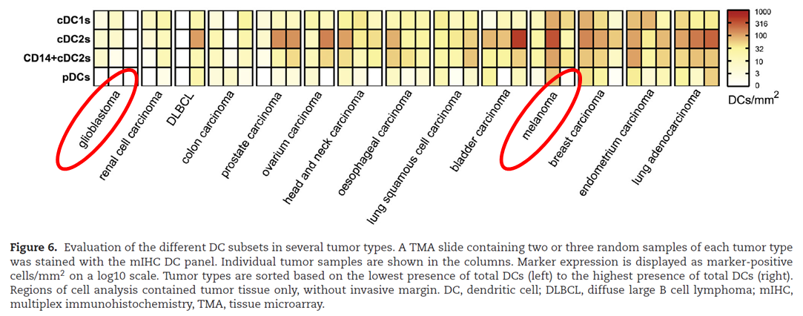
Brain Metastases
Immune Checkpoint Blockade
High Grade Glioma
High TMB
High TIS
Low TMB
Low TIS

Slide 10
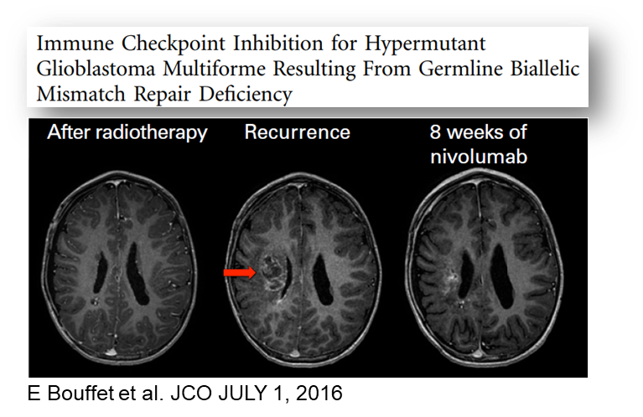
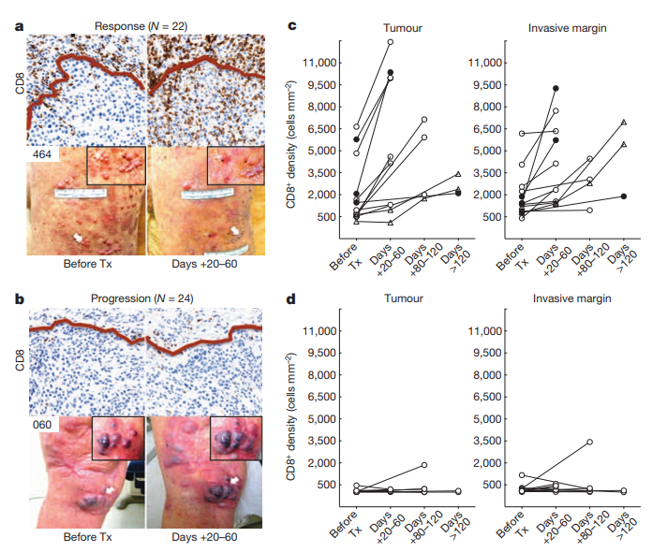
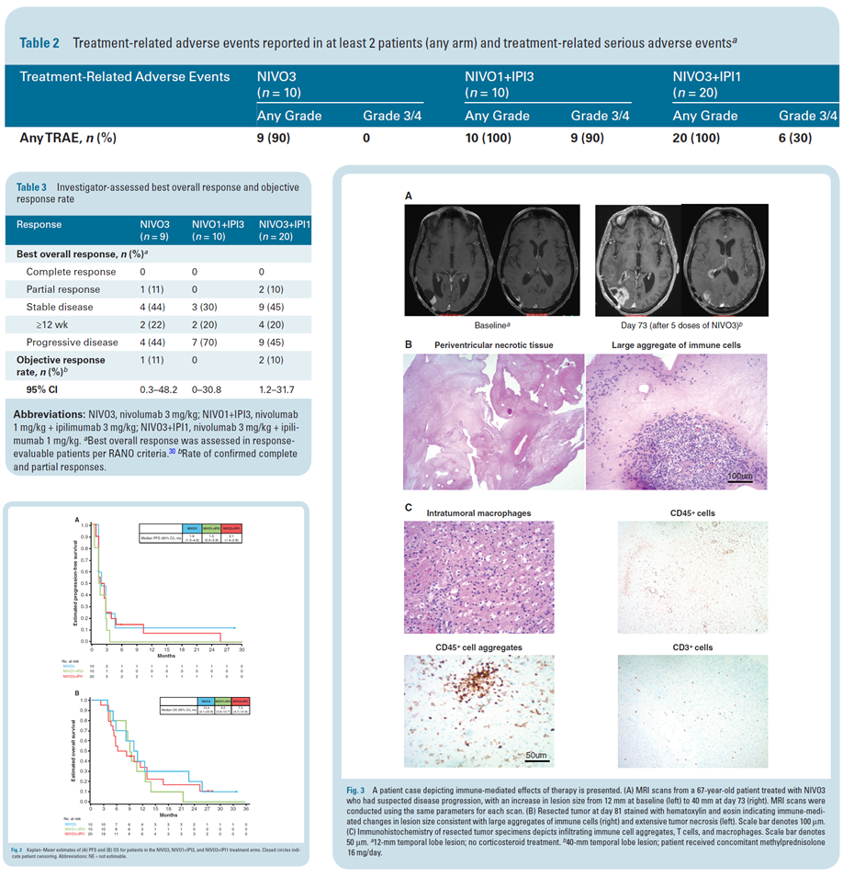
Brain Metastases
Immune Checkpoint Blockade
High Grade Glioma
Tumeh P. et al. Nature 2014
Omuro A.et al. Neuro-Oncology 2017

Slide 11
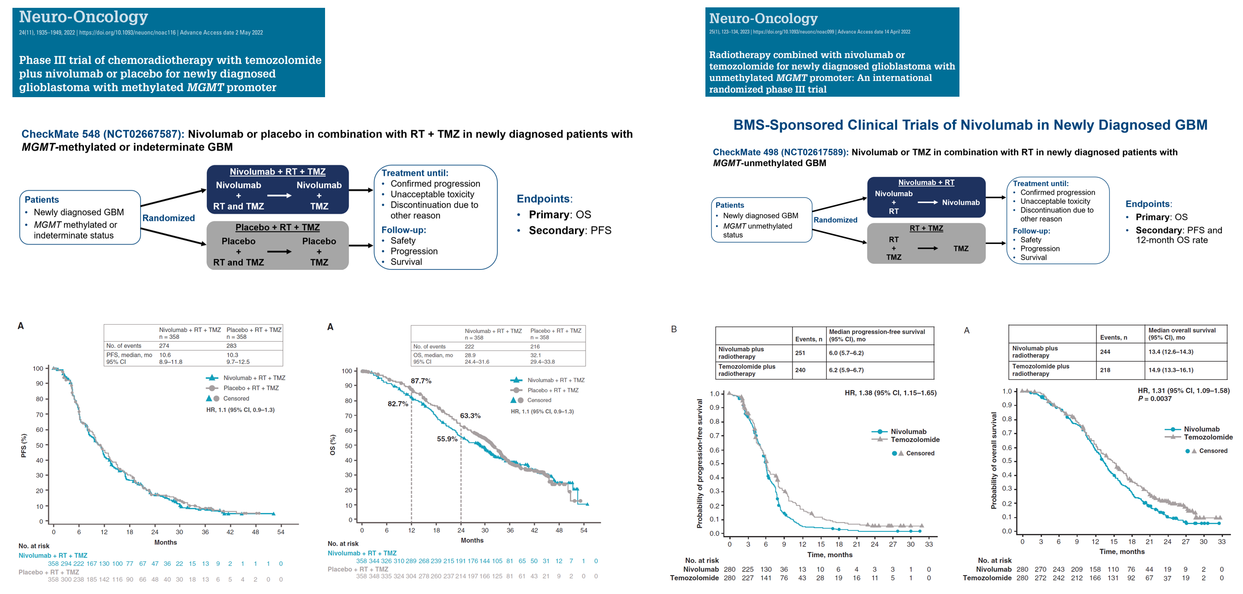
Brain Metastases
Immune Checkpoint Blockade
High Grade Glioma
CheckMate204
& ABC trials
Tawbi et al. NEJM 2018; Long G. et al. Lancet Oncol. 2018

Slide 12
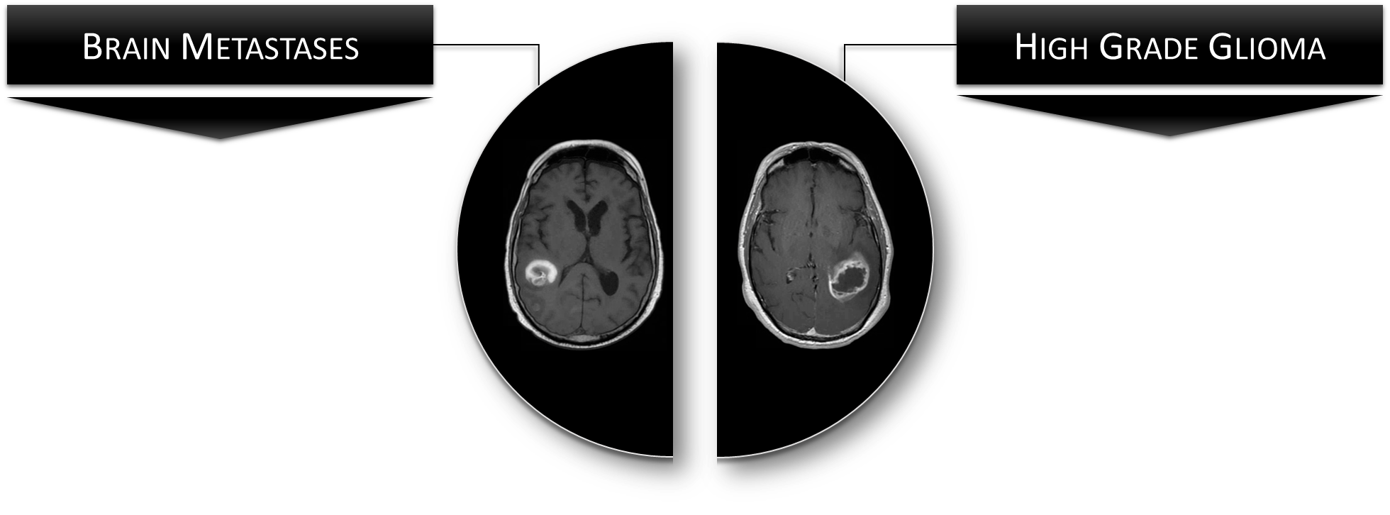
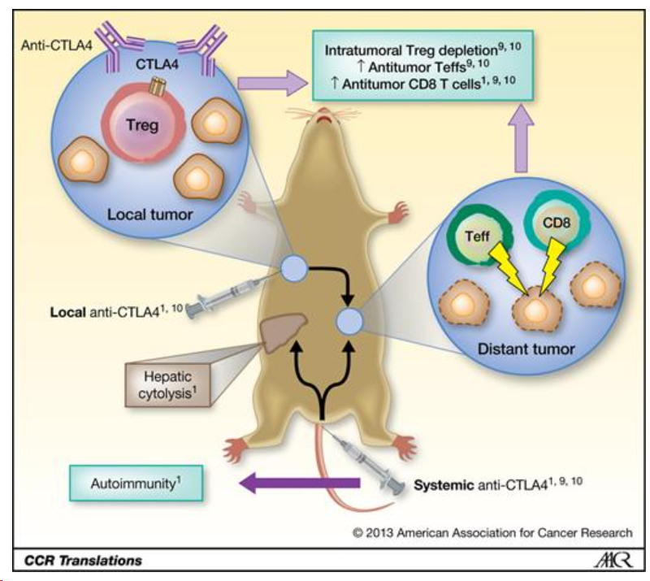
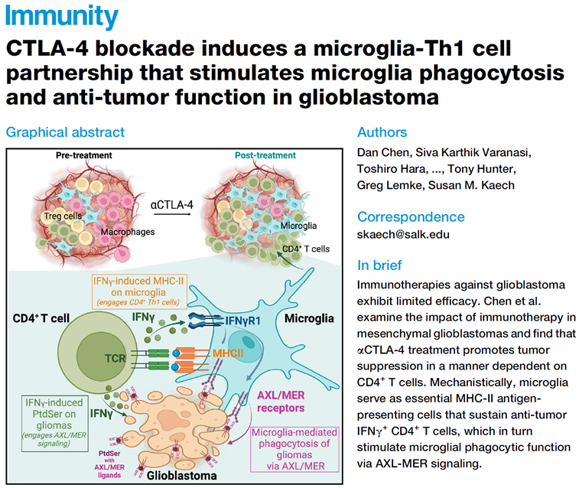
Marabelle A et al. J Clin Invest 2013; Fransen MF et al. Clin Cancer Res. 2013

Slide 13
Study Rational of the Glitipni trial program
Phase I clinical trial on the intracranial administration of autologous CD1c(BDCA-1)⁺/CD141(BDCA-3)⁺ myeloid dendritic cells in combination with ipilimumab and nivolumab in patients with recurrent high-grade glioma
Rational for the Glioma Intra-Tumoral Ipilimumab plus Nivolumab (GlITIpNi) multi-cohort adaptive phase I clinical trial:
Intra-cerebral administration of immune checkpoint mAb may results in a higher concentration & activity within the CNS (of particular interest for anti-CTLA4 mAb as immune-related toxicity is dose limiting following IV administration)
In preclinical models, intra-tumoral administration of anti-CTLA-4 mAb results in a superior risk/benefit ratio^{1,2}
Intracranial administration can be complemented with low-dose IV-administration of nivolumab (: anti-PD-1 mAb; 10 mg Q2w IV) to achieve full PD-1 blockade on T-cells in the systemic circulation^{3,4}
Rational for including CD1c(BDCA-1)⁺/CD141(BDCA-3)⁺ myeloid dendritic cells (myDC):
Conventional DCs (cDC1 and cDC2) are pivotal in orchestrating the anti-tumor immune response (both in the tumor micro-environment and secondary lymphoid organs)^{4,5}
Tumors evade eradication by the immune system by excluding cDC from their microenvironment or by induction of a tolerogenic cDC phenotype⁶
A clinical grade cDC cell product (classified as non-ATMP by EMA) can be obtained from PBMC by immuno-magnetic bead isolation using the CD1c(BDCA-1)⁺/CD141(BDCA-3)⁺ cell surface markers (following depletion of CD14⁺ and CD19⁺ cells)
Intratumoral injection of CD1c(BDCA-1)⁺/CD141(BDCA-3)⁺ myDC in combination with immune-checkpoint blockade, T-VEC, or AS01_{B} was feasible/safe and resulted in durable responses in immune-checkpoint refractory tumors⁷⁻¹⁰
¹ Marabelle A, etal. Clin Cancer Res 2013; ² Fransen MF, et al. Clin Cancer Res 2013; ³ Schwarze JK, et al. Cancers (Basel) 2022; ⁴ Brahmer JR, et al. Journal of Clinical Oncology 2010; ⁴ Broz ML, et al. Cancer Cell 2014; ⁵ Biinnewies M. et al Cancer Cell; 2019; ⁶ Spranger S, et al Cancer Cell 2017; ⁷ Schwarze JK et al.Vaccines (Basel) 2020; ⁸ Schwarze JK et al. J Immunother Cancer. 2022; ⁹ Tijtgat J. et al. J Immunother Cancer. 2024; ¹⁰ Vounckx M. et al. Cancer Immunol Immunother. 2024

Slide 14
Clinical Trial Design & Patient Enrollment
Primary endpoint: safety/feasibility; Phase I design: 3+3, with cohort expansion when considered appropriate
Eligibility: recurrent high-grade glioma (excl. 1p/19q LOH glioma; following prior surgery, RT and TMZ), no need for supra-physiological dosing of steroids
Cohort | Specific eligibility criteria | Recruitment Status | No° of patients | Study Treatment |  |  | Recruitment period
 |  |  |  | Per-operative^ |  | Post-operative |  |  |  | 2017 |  |  |  |  |  |  |  |  |  |  |  | 2018 |  |  |  |  |  |  |  |  |  |  |  | 2019 |  |  |  |  |  |  |  |  |  |  |  | 2020 |  |  |  |  |  |  |  |  |  |  |  | 2021 |  |  |  |  |  |  |  |  |  |  |  | 2022 |  |  |  |  |  |  |  |  |  |  |  | 2023
1* | Resectable | Completed | 3 | MSR | iCer 10 mg IPI | IV 10 mg NIVO Q2w x5
2* |  | Completed | 24 | MSR | iCer 5 mg IPI + 10 mg NIVO
3 | Unresectable | Completed | 16 | STx | iTum 5 mg IPI + 10 mg NIVO | IV 10 mg NIVO +iCav 1/5/10 mg NIVO Q2w x11
4° | Resectable | Completed | 16 | MSR | iCer 5 mg IPI + 10 mg NIVO
5 | Resectable | Completed | 20 (12+8) | MSR | iCer 5 mg IPI + 10 mg NIVO iCer myDC (5-, 10-, 20.10⁶) | IV 10 mg NIVO + iCav 10 mg NIVO Q2w x11
6 | Unresectable | Discontinued | 2 | STx | iTum 5 mg IPI + 10 mg NIVO iTum myDC (5-, 10-, 20.10⁶)
7° | Resectable | Completed | 29 | MSR | iCer 5 mg IPI + 10 mg NIVO iCav 1/5/10 mg IPI + 10 mg NIVO | IV 10 mg NIVO + iCav 10 mg NIVO + iCav 1/5/10 mg IPI Q2w x11
8 | Unresectable | Canceled | 0 | STx | iTum 5 mg IPI + 10 mg NIVO
9 | Unresectable | Discontinued | 3 |  |  | IV 10 mg NIVO + iThe 10 mg NIVO + iThe 1/5/10 mg IPI Q2w x11
MSR: maximal safe resection; STx: stereotactic tumor biopsy; iCer: intracerebral injection at 3-5 mm depth in the brain tissue lining the resection cavity; iCav: injection in the resection cavity through an Ommaya reservoir; iTum: intratumoral; iThe: intrathecal; ^: including the first dose of IV Nivo that was administered 24 hours prior to the neurosurgical intervention; NIVO: nivolumab; IPI: ipilimumab; IV: intravenous; *: Duerinck J, et al. JITC 2021; °: Neyns B, et al. ASCO AM 2024.

Slide 15
Baseline Demographics and Prior Therapy
Baseline Demographics and Prior Therapy |  |  | Cohorts, N (%)
 |  | 1 | 2 | 3 | 4 | 5 | 6 | 7 | 9
Patient No° |  | 3 | 24 | 16 | 16 | 20 | 2 | 29 | 3
Age | Median (years; range) | 67 (38-72) | 55 (38-74) | 56 (34-74) | 56 (42-77) | 51 (20-78) | 50 (42-58) | 60 (32-74) | 34 (28-43)
Gender | Male/Female | 1 (33)/ 2 (67) | 16 (67)/ 8 (33) | 11 (69)/ 5 (31) | 12 (75)/ 4 (25) | 12 (60)/8 (40) | 2/0 | 21 (72)/ 8 (28) | 3 (100)/ 0
Etnicity | Caucasion/Other | 3 (100)/ 0 | 22 (92)/ 2 (8) | 16 (100)/0 | 15 (94)/ 1 (6) | 19 (95)/1 (5) | 2 (100)/0 | 28 (97)/ 1 (3) | 3 (100)/ 0
WHO PS | 0/1/2 | 1 (33)/ 2 (67) / 0 | 9 (38)/ 12 (50)/ 3 (12) | 7 (44)/ 6 (37)/ 3 (19) | 6 (37)/ 7 (44)/ 3 (19) | 15 (75)/5 (25)/0 | 2/0/0 | 21 (72)/ 8 (28)/ 0 | 0 / 3 (100)/ 0
Integrated molecular & histopathological diagnosis (WHO classification 2021) | Glioblastoma, IDH wildtype | 3 (100) | 22 (92) | 11 (69) | 15 (94) | 16 (80) | 1 (50) | 26 (90) | 0
 | Astrocytoma, IDH mutant | 0 | 2 (8) | 4 (25) | 1 (6) | 3 (15) | 1 (50) | 2 (7) | 2 (67)
 | Oligodendroglioma, IDH mutant + 1p19q LOH | 0 | 0 | 1 (6) | 0 | 0 | 0 | 0 | 0
 | Other | 0 | 0 | 0 | 0 | 1 (5) | 0 | 1 (3) | 1 (33)
MGMT-methylation status | Methylated | 0 | 4 (17) | 3 (19) | 7 (44) | 4 (20) | 0 | 6 (21) | 0
 | Unmethylated | 0 | 7 (29) | 1 (6) | 4 (25) | 12 60() | 1 (50) | 19 (66) | 2 (66)
 | Unknown | 3 (100) | 13 (54) | 12 (75) | 5 (31) | 4 (20) | 1 (50) | 4 (14) | 1 (33)
Prior surgical intervention | Resection/Biopsy | 3 (100)/ 0 | 24 (100)/ 0 | 16 (100)/ 0 | 16 (100)/ 0 | 20 (100)/0 | 2/0 | 29 (100)/ 0 | 2 (67)/ 1 (33)
Prior initial therapy | Surgery + RT/TMZ + adjuv TMZ | 3 (100) | 21 (87) | 12 (75) | 14 (87) | 18 (90)* | 1 (50) | 27 (93) | 1 (33)
 | Other | 0 | 3 (13) | 4 (25) | 2 (13) | 2 (10) | 1 (50) | 2 (7) | 2 (66)
Prior therapy for recurrent disease | Surgery + RT/CT + adjuvant CT | 0 | 1 (4) | 1 (6) | 0 | 0 | 0 | 1 (3) | 0
 | Surgery + CT + immunoT | 0 | 0 | 0 | 1 (6) | 0 | 0 | 0 | 0
 | Surgery + CT | 0 | 1 (4) | 2 (12) | 4 (25) | 2 (10) | 0 | 7 (24) | 0
 | Surgery + immunoT | 0 | 0 | 0 | 1 (6) | 0 | 0 | 0 | 0
 | Surgery | 0 | 2 (8) | 1 (6) | 2 (12) | 1 (5) | 1 (50) | 1 (3) | 0
 | RT |  |  | 0 | 0 | 1 (5) | 0
 | CT +RT | 0 | 1 (4) | 1 (6) | 0 | 1 (5) | 0 | 0 | 0
 | CT | 0 | 2 (8) | 2 (12) | 1 (6) | 1 (5) | 1 (50) | 2 (7) | 1 (33)
 | None | 3 (100) | 17 (71) | 9 (56) | 7 (44) | 2 (10) | 0 | 18 (62) | 1 (33)
 | Biopsy+CT | 0 | 0 | 0 | 0 | 0 | 0 | 0 | 1 (33)

Slide 16
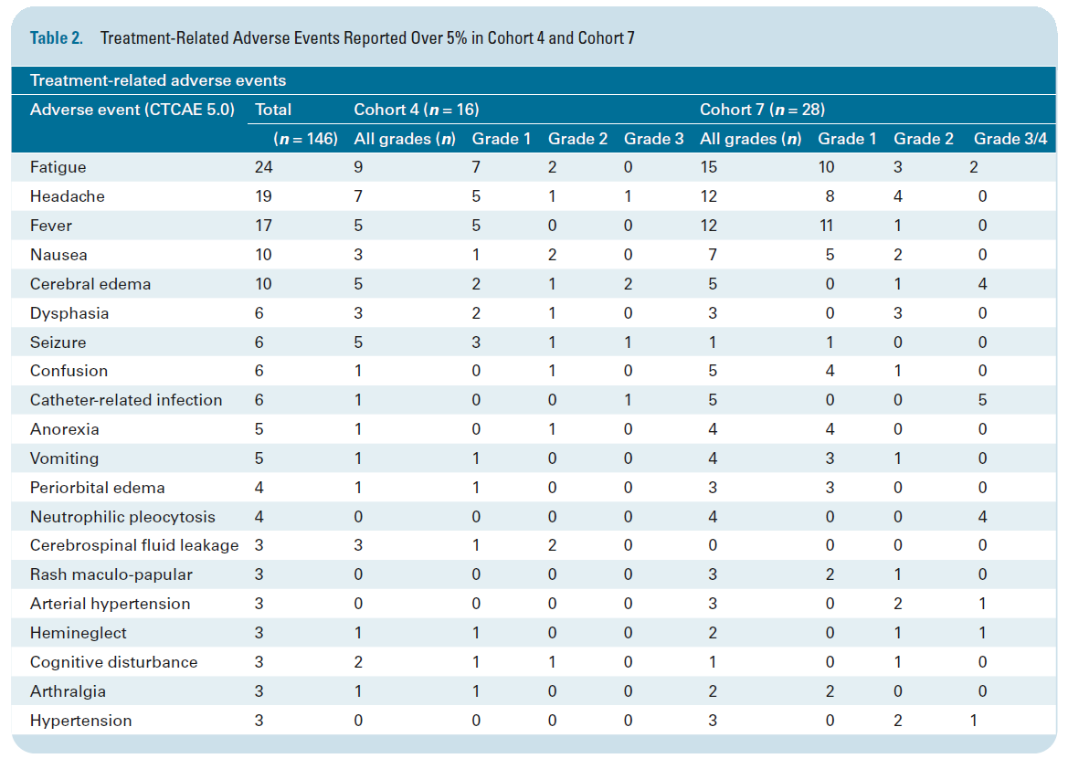

Slide 17
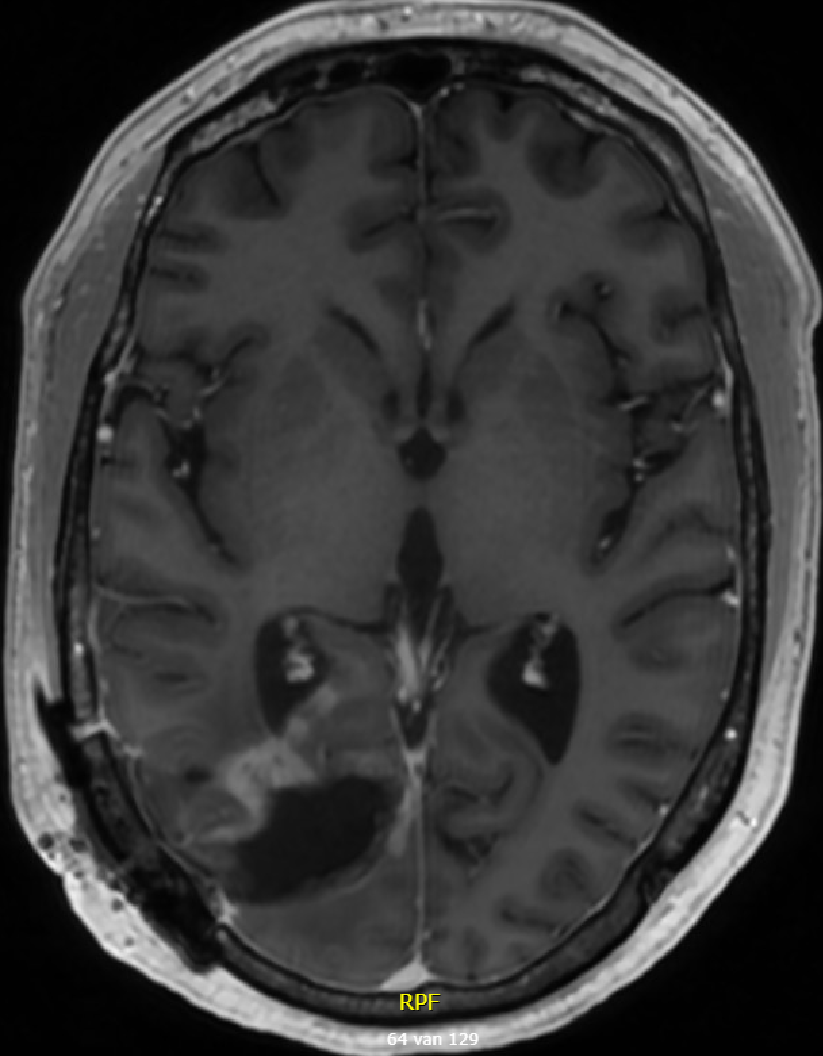
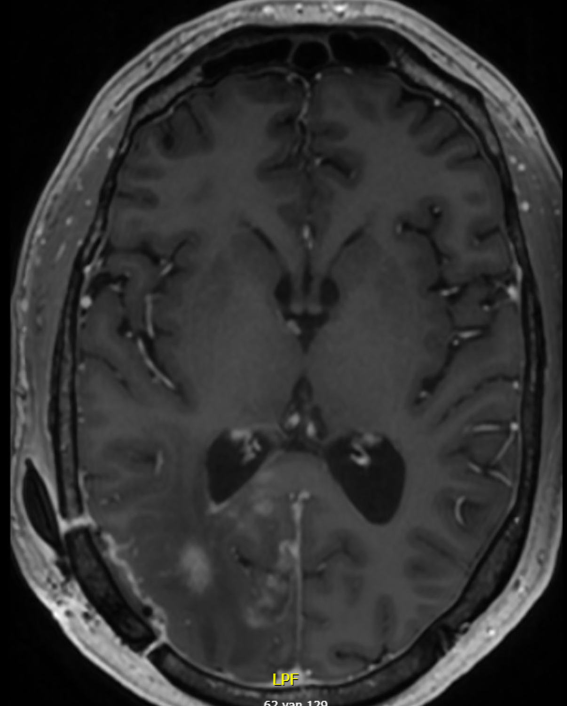
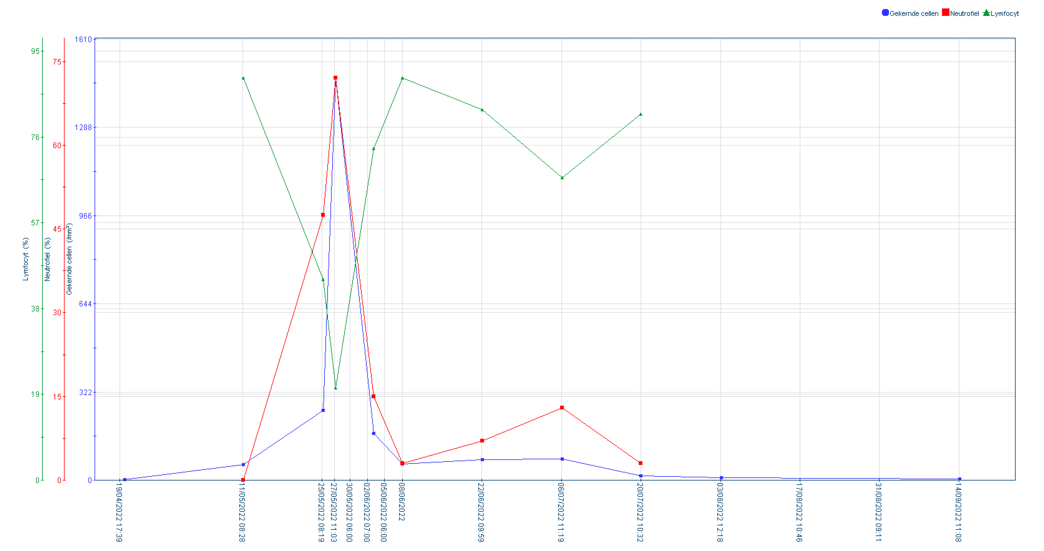
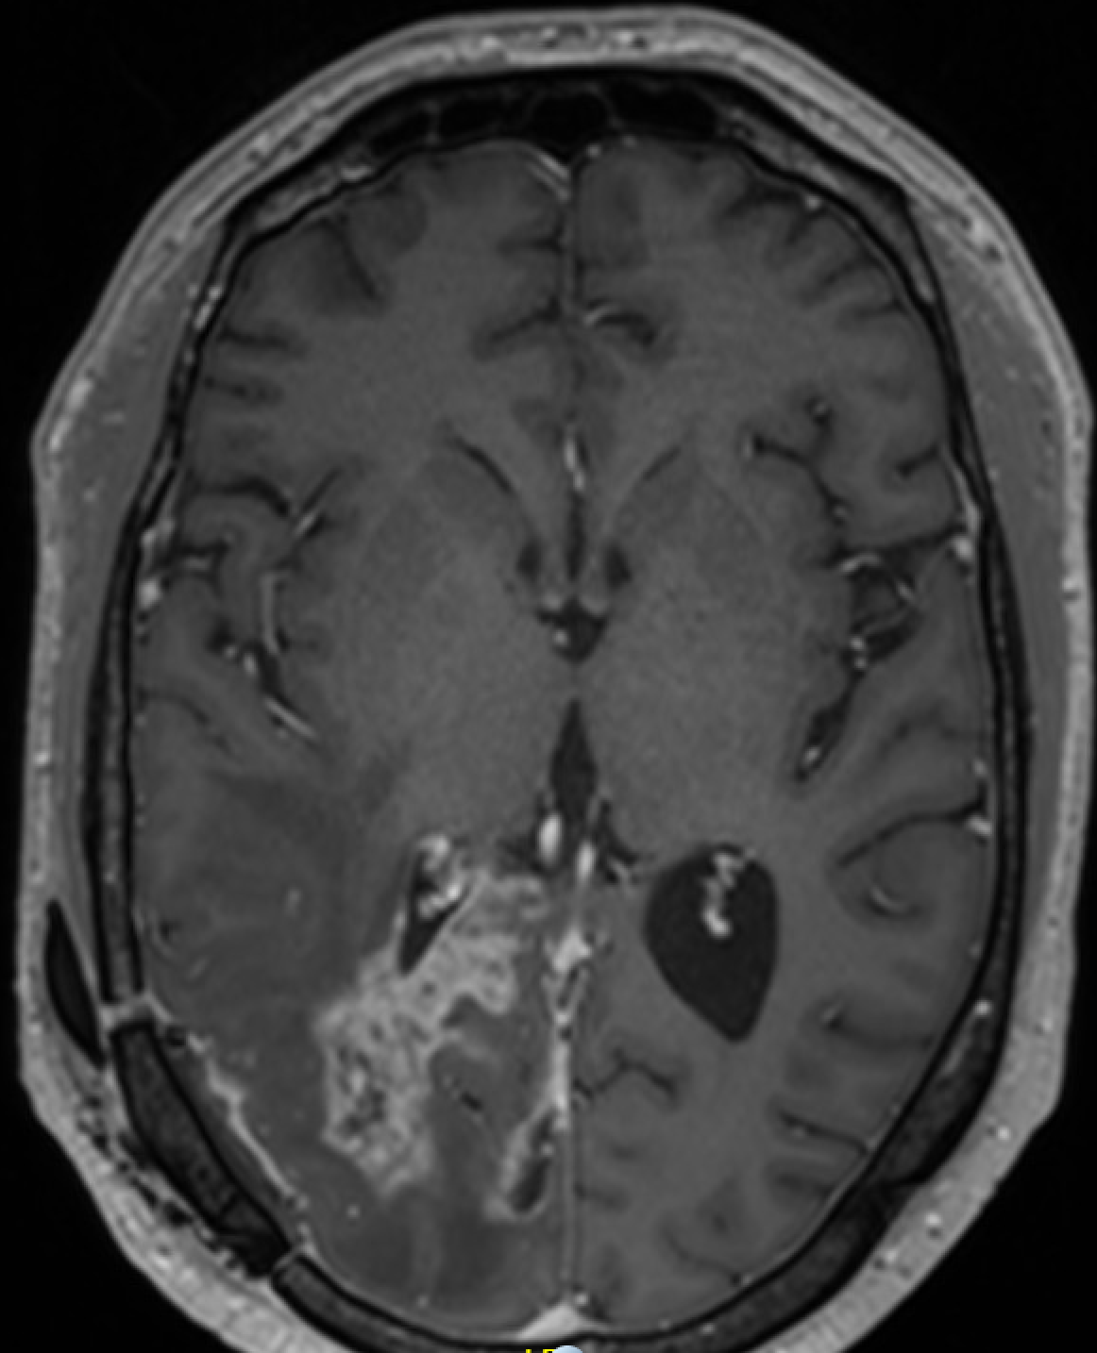
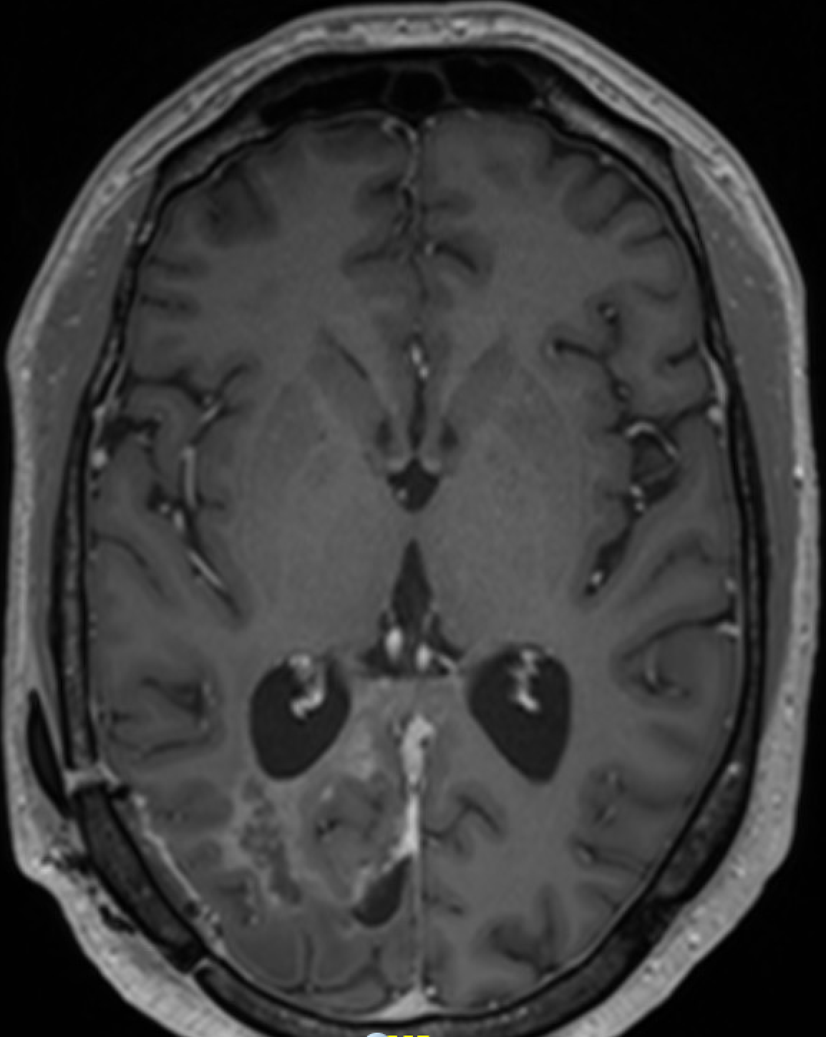
Adverse Events (Cohort-7)
Sterile neutrophilic pleocytosis, fever (G1), neurological deterioration (G2) – SAE (hospitalization, antibiotic therapy)
Dose level iCav Ipilimumab = 10mg: 2 out of 11 pts (18%); 5mg: 1 out of 6 pts (16%); 1mg 0 out of 9 pts
Full recovery in all cases (steroids used in 1 pt)
Case Illustration: 44yM, IDH1wt glioblastoma, PD following resection, RT(60Gy)/TMZ and 6 cycles adj TMZ
11 MAY 2022
8 JUN 2022
17 JUL2022
31 AUG 2022

Slide 18
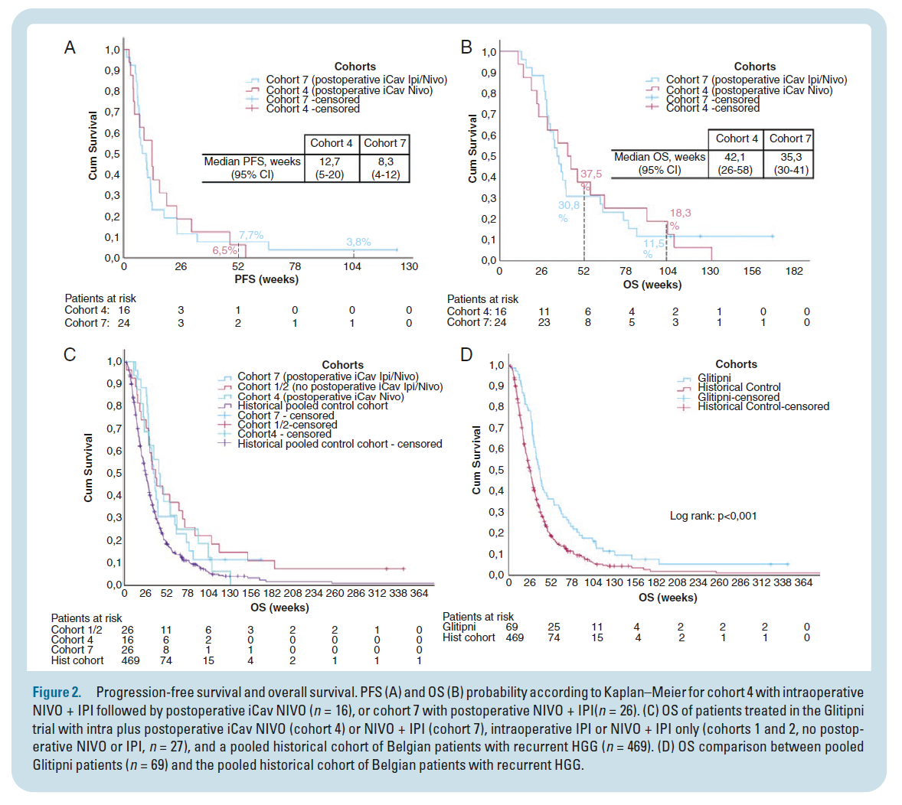
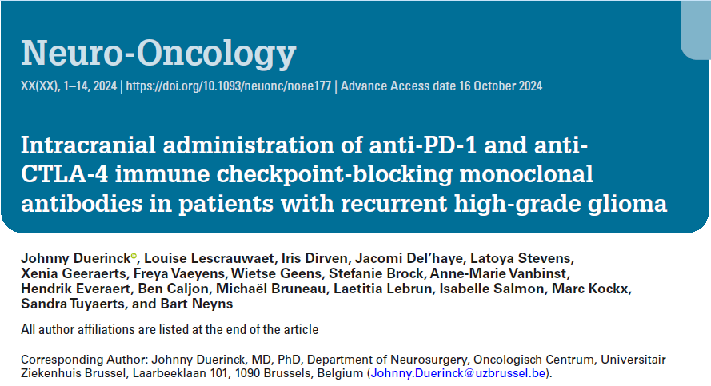
Intracaranial administration of PD-1 and CTLA-4 blocking mAb may improve OS in patients with resectable recurrence of a high-grade glioma
Postoperative intracavitary administration of ICB mAb’s is unlikely to improve outcome

Slide 19
Presentation Number 441O
A phase I clinical trial on the intracranial administration of autologous CD1c(BDCA-1)⁺ /CD141(BDCA-3)⁺ myeloid dendritic cells (myDC) in combination with ipilimumab (IPI) and nivolumab (NIVO) in patients with recurrent high-grade glioma (rHGG)
Bart Neyns¹, Iris Dirven¹, Louise Lescrauwaet², Manon Cammaert¹, Wietse Geens², Xenia Geeraerts¹, Latoya Stevens¹, Stefanie Brock³, Mark Kockx⁶, Hendrik Everaert⁴, Anne-Marie Vanbinst⁵, Sandra Tuyaerts¹, Johnny Duerinck²
Departments of medical oncology¹, neurosurgery², pathology³, nuclear medicine⁴, and radiology⁵ of the Universitair Ziekenhuis Brussel, Brussels, Belgium, and CellCarta⁶, Antwerp, Belgium
Bart.Neyns@uzbrussel.be
Universitair Ziekenhuis Brussel (UZ Brussel)
Brussels, Belgium

Slide 20
Adverse Events
There were no grade 5 or Suspected Unexpected Serious Adverse Reactions (SUSARs)
No patient required corticosteroid therapy (or other immunosuppressive treatment) for management of immune-related adverse events
CTCAE type of Adverse Events | Cohort 5 & 6 (n=21)
 | No. | % | Grade 1 | Grade 2 | Grade 3 | Grade 4
Any grade AE (total # of events) | 59 | (100) | 34 | 19 | 5 | 1
Grade 3/4 AE (total # of events) | 11 | (52) | - | - | 10 | 1
Treatment related grade 3/4 AE (total # of events) | 8 | (38)
Most frequent AE’s
Fatigue | 10 | (48) | 6 | 4 | 0 | 0
Headache | 8 | (38) | 6 | 2 | 0 | 0
Dysphasia | 6 | (29) | 3 | 2 | 1 | 0
Nausea | 5 | (24) | 2 | 3 | 0 | 0
Fever | 4 | (19) | 4 | 0 | 0 | 0
Ommaya reservoir bacterial colonization* | 3 | (14) | 0 | 2 | 1 | 0
Vomiting | 4 | (19) | 3 | 1 | 0 | 0
Periorbital edema | 3 | (14) | 3 | 0 | 0 | 0
Seizure° | 3 | (14) | 3 | 0 | 0 | 0
Adverse reactions of special interest
Craniotomy dehiscence* | 2 | (9.5) | 0 | 2 | 0 | 0
Hyperthyroidism | 2 | (9.5) | 1 | 1 | 0 | 0
Adrenal insufficiency (loss of ACTH production) | 1 | (5) | 0 | 0 | 1 | 0
Pneumocephalus | 1 | (5) | 0 | 1 | 0 | 0
Arthralgia (with systemic inflammation) | 1 | (5) | 0 | 1 | 0 | 0
Subacute symptomatic cerebral edema (prior to post-surgical treatment) | 1 | (5) | 0 | 0 | 1 | 0
Hypothyroidism | 1 | (5) | 1 | 0 | 0 | 0
Bacterial meningitis* | 1 | (5) | 0 | 0 | 0 | 1
* One patient developed a craniotomy wound dehiscence that became infected and caused a bacterial meningitis ° One patient experienced a partial epileptic insult following the iCav administration of NIVO

Slide 21
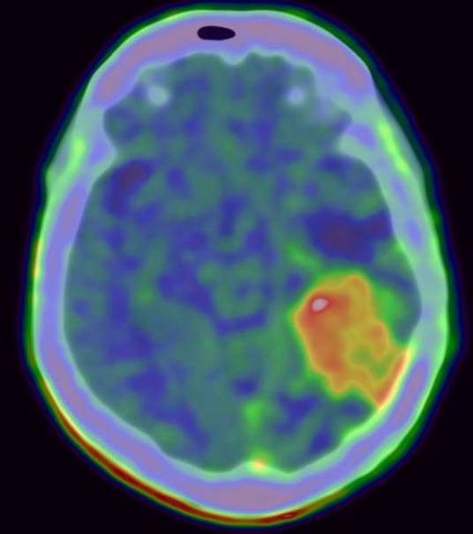
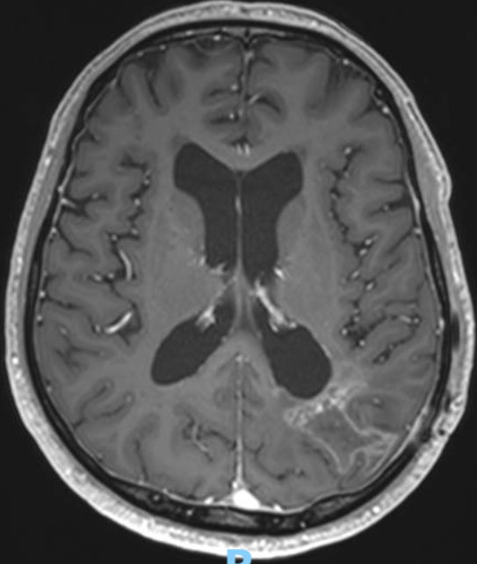
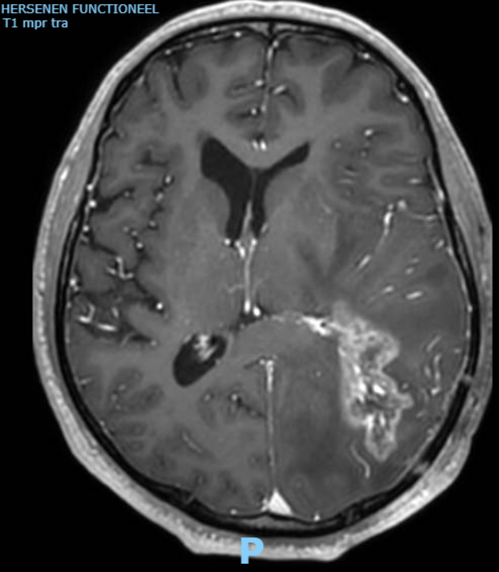
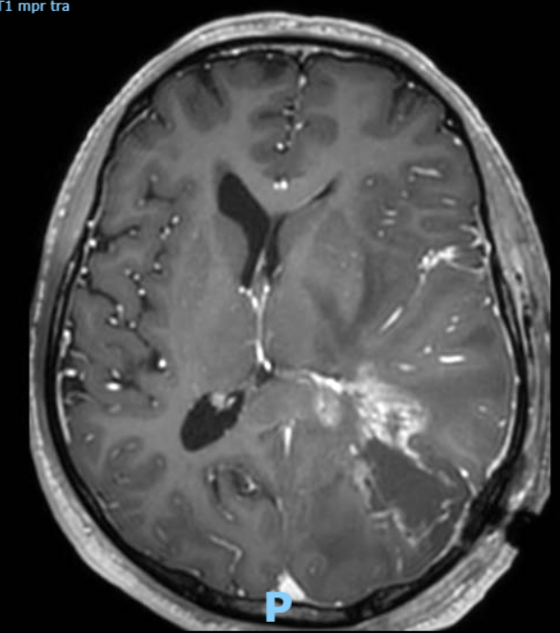
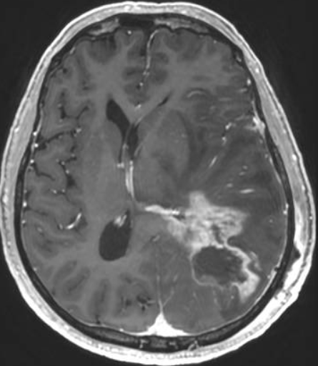
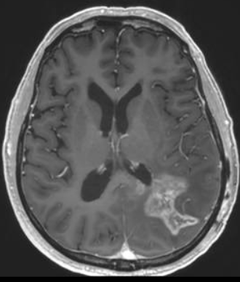
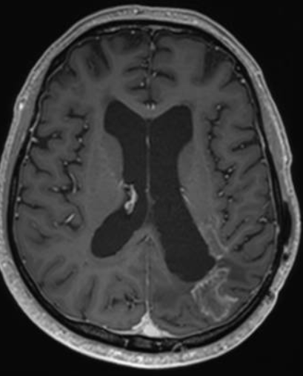
Early symptomatic progression benefitting long-term from low-dose bevacizumab*
Case Illustration: 62y Male, glioblastoma (IDH^{wt}, TERT^{MUT}, NF1^{MUT}, MGMTpromoter^{unmeth})
Complete resection followed by RT (30x2Gy ) + TMZ, and adjuvant 3x TMZ 5/28d
FET-PET
Axial Gd-T1 MRI
Day -5
Day +1
Day +17
Week
6
Week
14
Week
51
Resection +
Nivo 10 mg
Ipi 5mg
20 10⁶ myDC
Methylprednisolone 40 mg IV BID
14d-taper
to 8 mg QD
Bevacizumab 400 mg IV followed by 100 mg Q4w
* J. Tijtgat et al. Cancers (Basel). 2023 Apr 29;15(9):2560.

Slide 22
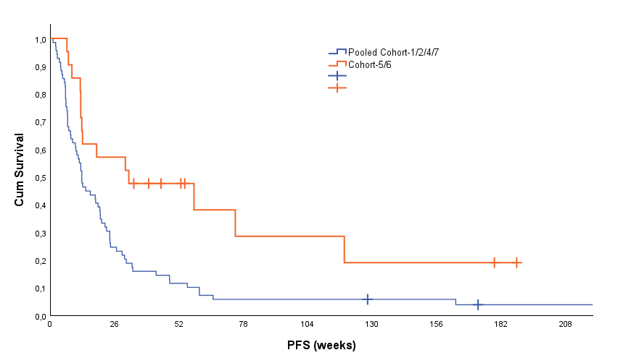
Progression-Free Survival (PFS-2)
Time to first progression on MRI of the brain + PFS2 on low-dose bevacizumab for responders (Cohort 5/6: 4 patients; Cohort-1/2/4/7: 10 patients)
 | 1y PFS% (95% CI) | 2y PFS% (95% CI)
Pooled Cohort-1/2/4/7 | 11.6 (4-19) | 5.8 (0-11)
Cohort-5/6 | 47 (40-55) | 28 (5-52)
Log Rank p .003 *
Pooled Cohort-1/2/4/7 | 69 | 17 | 8 | 4 | 4 | 3 | 3 | 1 | 1
Cohort-5/6 | 21 | 12 | 7 | 3 | 3 | 2 | 2 | 1 | 0
*: descriptive p-value

Slide 23
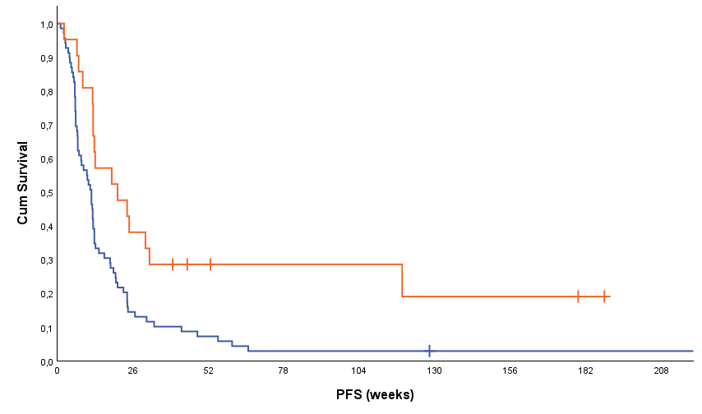
Progression-Free Survival
Time to first progression on MRI of the brain
 | 1y PFS% (95% CI) | 2y PFS% (95% CI)
Pooled Cohort-1/2/4/7 | 7.2 (1-13) | 2.9 (0-7)
Cohort-5/6 | 28 (9-48) | 28 (9-48)
Log Rank p .005 *
Pooled Cohort-1/2/4/7 | 69 | 10 | 5 | 2 | 2 | 1 | 1 | 1 | 1
Cohort-5/6 | 21 | 8 | 4 | 3 | 3 | 2 | 2 | 1 | 0
*: descriptive p-value

Slide 24
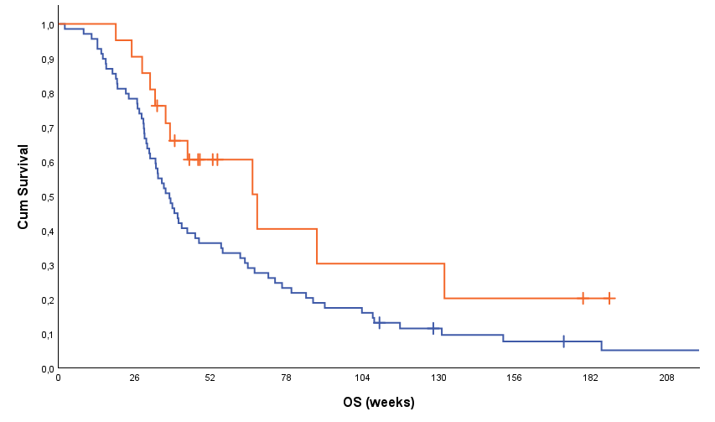
Overall Survival
Time to death or latest follow-up
 | 1y PFS% (95% CI) | 2y PFS% (95% CI)
Pooled Cohort-1/2/4/7 | 36 (25-47) | 17 (8-26)
Cohort-5/6 | 60 (39-82) | 30 (4-56)
Log Rank p .046 *
Pooled Cohort-1/2/4/7 | 69 | 54 | 25 | 16 | 11 | 6 | 4 | 3 | 2
Cohort-5/6 | 21 | 19 | 8 | 4 | 3 | 3 | 2 | 1 | 0
*: descriptive p-value

Slide 25
Conclusions
Phase I clinical trial on the intracranial administration of autologous CD1c(BDCA-1)⁺/CD141(BDCA-3)⁺ myeloid dendritic cells in combination with ipilimumab and nivolumab in patients with recurrent high-grade glioma
The investigated intracranial administration of IPI and NIVO pus CD1c(BDCA-1)⁺/CD141(BDCA-3)⁺ myeloid dendritic cells is feasible and associated with an acceptable safety profile
No treatment limiting toxicity defined (low-incidence/-severity of immune-related adverse events)
Postoperative intracavitary NIVO associated with a risk for bacterial colonization of the Ommaya reservoir and bacterial meningitis
Early indication suggesting a potential beneficial effect on survival
Intracerebral myDC may improve survival (as opposed to postoperative intra-cavitary NIVO +/- IPI) deserving further investigation
Low-dose bevacizumab provided additional durable PFS beyond first progression in a subgroup of patients
Perspectives/opportunities
Investigation of predictive/prognostic glioma tissue and myDC biomarkers is ongoing and may help to guide patient selection
Investigation of the nature and tumor-antigen specificity of the lymphocytes present in the CSF
Neo-adjuvant IV followed by per- and postoperative IPI/NIVO is under investigation (Neo-Glitipni, NCT06097975) and may serve as a future backbone for adding-on CD1c(BDCA-1)⁺/CD141(BDCA-3)⁺ myeloid dendritic cells

Slide 26
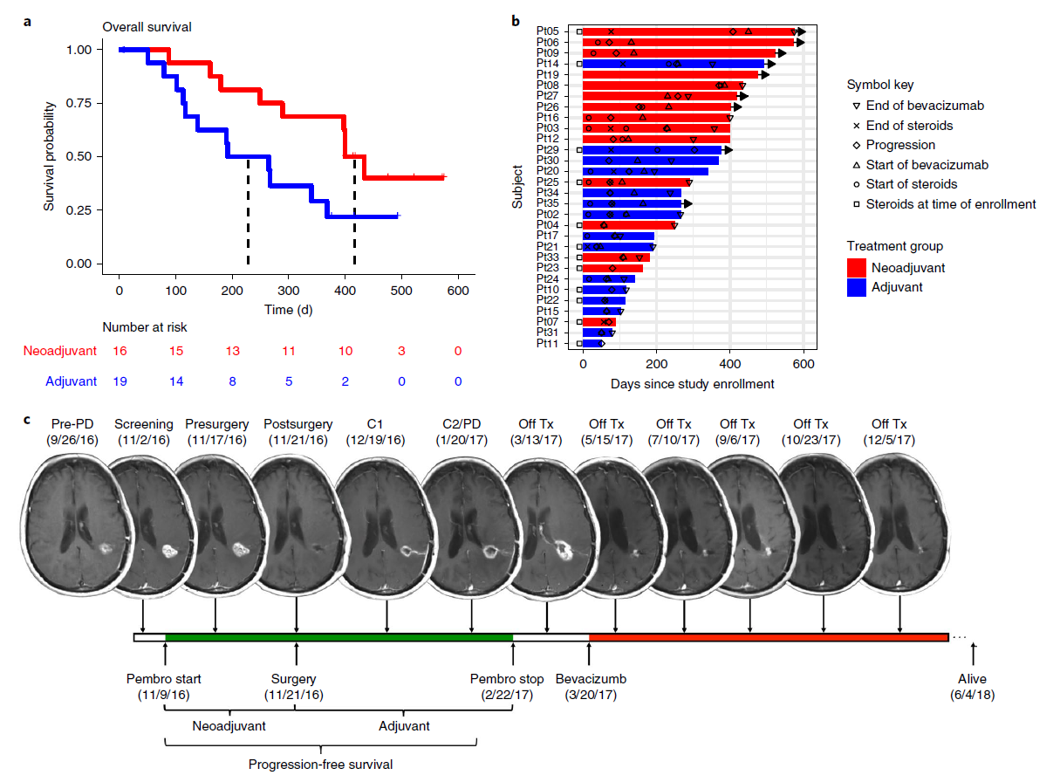
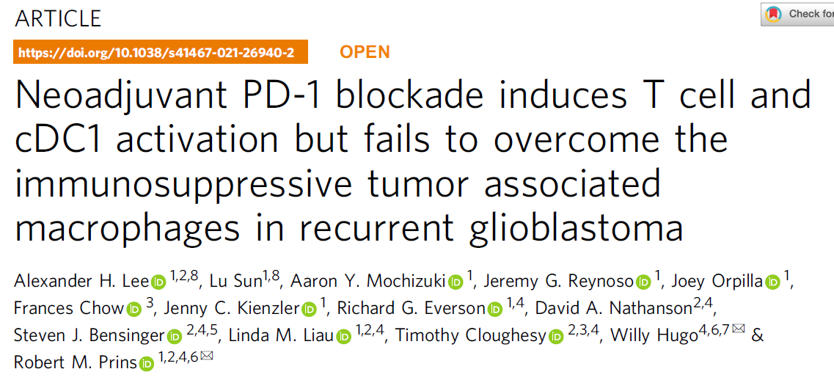
Brain Metastases
High Grade Glioma
https://melanoma.org.au/news/melanoma-science-race-against-brain-cancer-national-press-club/

Slide 27
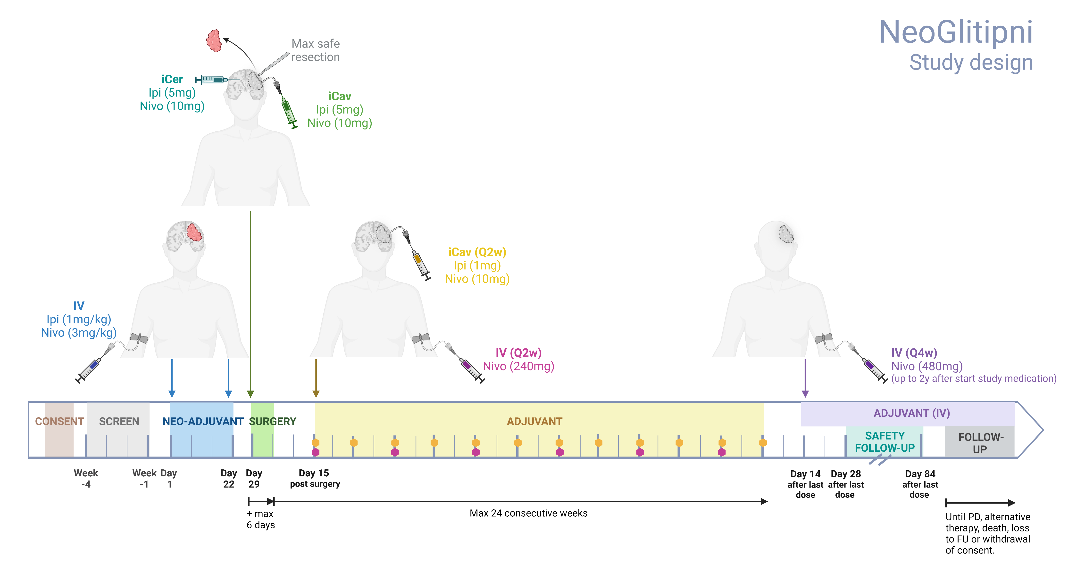
Ongoing

Slide 28
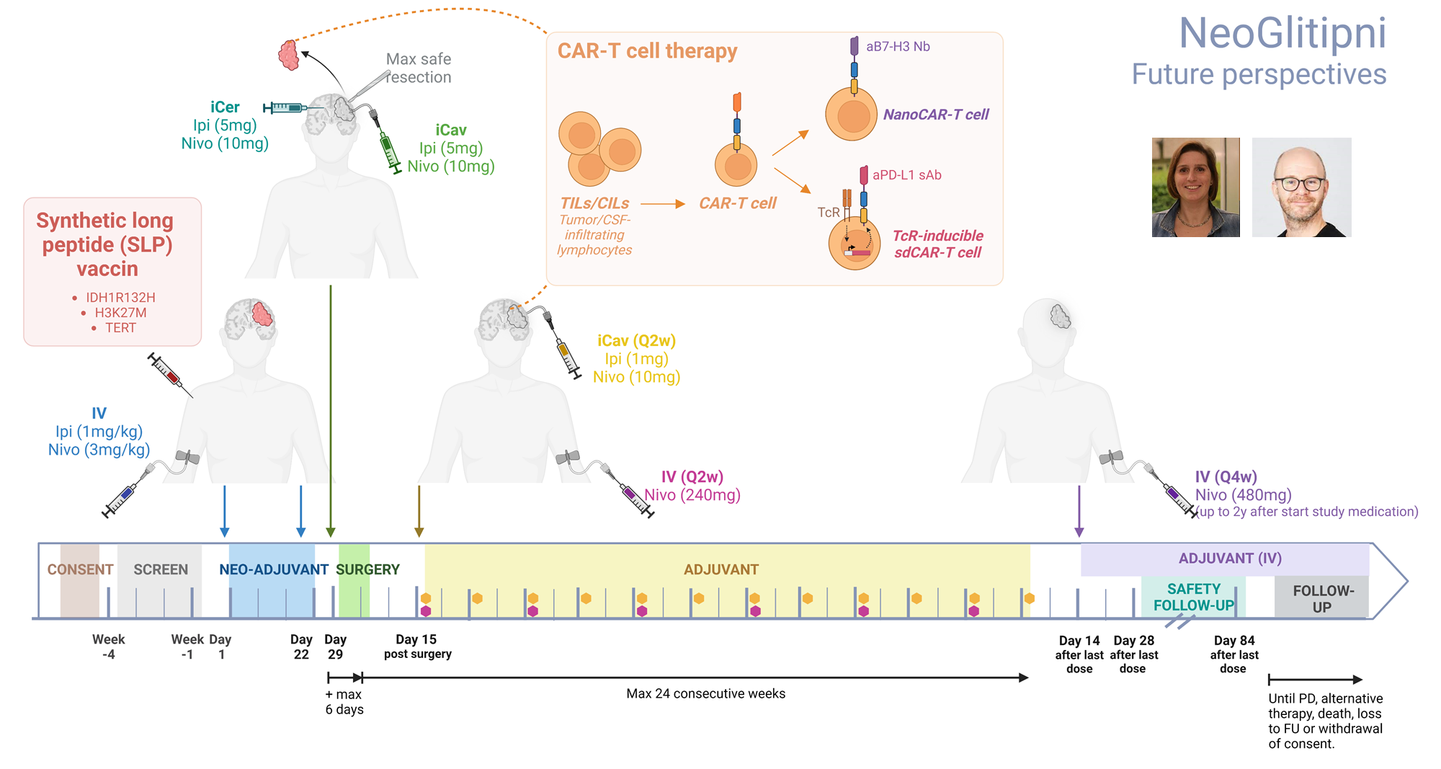
Karine Breckpot
Nick
Devoogd
Jordy Schaukens
Xenia Geeraerts

Slide 29
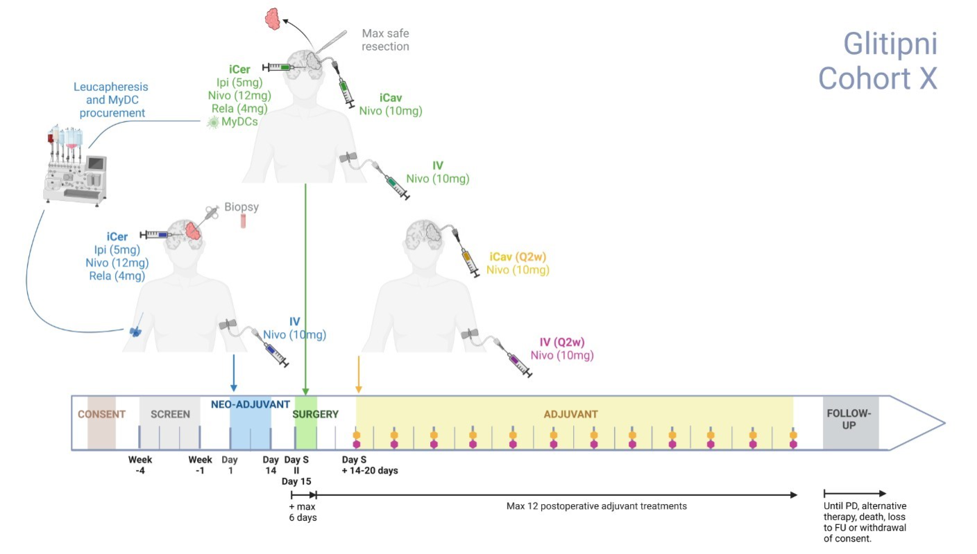

Slide 30
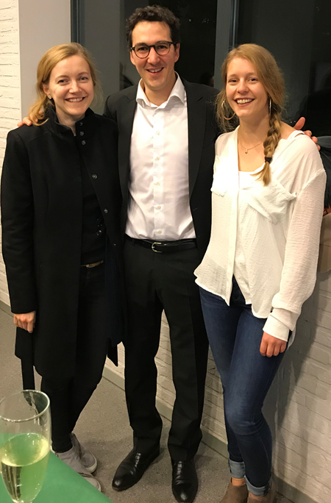
Acknowledgements

Slide 31
DANK U !

